Slide 1
Business Case Study on Retail and Data Analytics
2025
Presented by-Aditya Patil

Slide 2
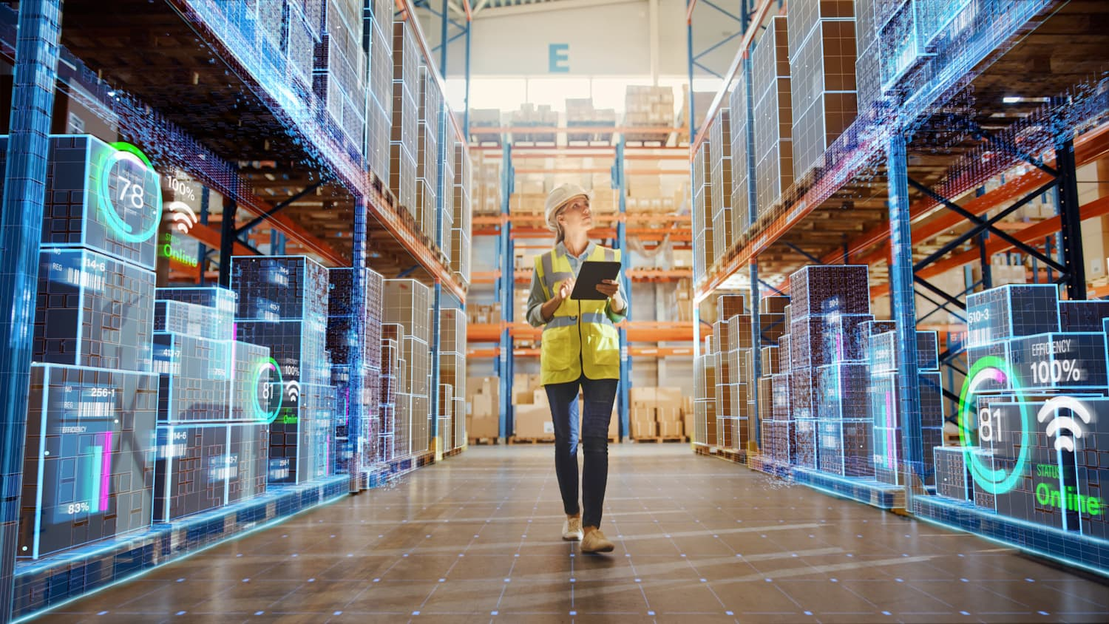

Introduction to Retail
2025
The retail industry refers to the sector of the economy that involves the sale of goods and services directly to consumers. It includes a wide range of businesses, from small local shops to large multinational chains and e-commerce platforms. Retailers serve as intermediaries between manufacturers or wholesalers and end consumers, offering products in physical stores, online marketplaces, or through omnichannel strategies.
The retail industry is a critical driver of economic activity, employment, and consumer spending. It contributes significantly to GDP in many countries and plays a key role in global trade, logistics, and supply chain networks. The sector also reflects broader economic trends, as consumer spending is often an indicator of economic health.
What is the retail industry? Provide a brief overview of the retail sector and its relevance in the global economy.

Slide 3
Retail Sector
Types of Retail – The industry is divided into various formats, including supermarkets, department stores, specialty stores, convenience stores, discount retailers, and online retail.
E-commerce Growth – The rise of digitalization has significantly impacted retail, with online shopping platforms like Amazon, Alibaba, and Shopify playing a major role in reshaping consumer habits.
Consumer Trends – Changing consumer preferences, such as demand for personalized shopping experiences, sustainability, and convenience, drive innovation in the sector.
Technology & Innovation – Retailers leverage artificial intelligence (AI), data analytics, automation, and supply chain advancements to enhance customer experience and operational efficiency.
Challenges – The industry faces challenges such as supply chain disruptions, inflation, high competition, and shifts in consumer behavior due to economic and social changes.
2025
Overview

Slide 4


Examples
2025
Walmart (USA)
Amazon (USA)
Target (USA)
The world's largest retailer by revenue, Walmart operates a vast network of hypermarkets, discount stores, and e-commerce platforms. Efficient supply chain, economies of scale, low-cost pricing strategy, and strong global presence.
Key Stats: Over 10,500 stores in 19 countries, annual revenue exceeding $600 billion.
A global e-commerce giant, Amazon started as an online bookstore and expanded into various sectors, including cloud computing and AI. Customer-centric approach, fast delivery, technological innovation (AI, cloud computing), and a massive third-party marketplace.
Key Stats: Market leader in e-commerce, AWS (cloud services), and Prime membership with millions of subscribers.
A leading American discount retailer known for its affordable yet stylish merchandise. Strong brand identity, private label products, competitive pricing, and successful omnichannel retail strategies.
Key Stats: Over 1,900 stores in the U.S., annual revenue surpassing $100 billion.

Slide 5
Role of Data Analytics in Retail
2025
Customer Experience
Supply Chain Optimization
Inventory Management Optimization
Personalized Recommendations, AI-driven recommendation engines analyze customer browsing and purchase history to suggest relevant products, enhancing sales and customer experience.
Customer Segmentation, Machine learning groups customers based on demographics, purchasing behavior, and preferences, allowing retailers to create targeted marketing campaigns.
Chatbots & Virtual Assistants, AI-powered customer service tools that assist with inquiries, recommendations, and support. (Example: Sephora’s chatbot provides beauty advice.)
Predictive Analytics for Demand Forecasting, AI analyzes historical sales data and trends to predict future demand, preventing stock shortages and excess inventory.
Supplier Performance Analytics, Retailers assess supplier reliability by tracking delivery times, defect rates, and pricing trends to improve sourcing decisions.
Automated Warehouse Management, Smart warehouses use IoT and AI to track inventory movement, automate restocking, and minimize manual errors. (Example: Walmart’s real-time inventory tracking system.)
Real-Time Inventory Tracking, RFID and IoT sensors continuously monitor stock levels across multiple store locations, improving stock accuracy.
Automated Replenishment, AI-driven systems automatically reorder products when stock falls below a set threshold, ensuring shelves stay stocked.
Seasonal Trend Analysis, Retailers use past sales data to anticipate seasonal fluctuations in demand and adjust inventory levels accordingly.

Slide 6
How Analysts Use Data To Optimize
2025
In-Store Layout Optimization
Data-Driven Pricing Strategies
Enhancing Customer Service with AI
Heatmap Analytics – Uses cameras, IoT sensors, and POS data to track customer movement, identifying high-traffic areas for optimal product placement.
A/B Testing Layouts – Tests different store designs to determine which layout drives more sales and engagement.
Endcap Optimization – Uses sales data to decide which products to place in high-visibility end-of-aisle displays for maximum impact.
Dynamic Pricing – AI-driven pricing tools adjust product prices in real time based on demand, competitor pricing, and stock levels.
Geographical Pricing – Adjusts prices based on location-specific demand and local purchasing power.
Markdown Optimization – Predicts the best timing and discount levels for clearance items to maximize revenue while minimizing losses.
Chatbots & Virtual Assistants – AI-powered tools handle customer inquiries, provide recommendations, and improve shopping experience.
Queue Optimization – Predictive models analyze peak hours and adjust staffing levels to reduce wait times at checkout.
Sentiment Analysis – Monitors online reviews and social media feedback to proactively address customer concerns.
Employee Analytics – Uses data insights to evaluate staff performance and identify training needs for better service.

Slide 7
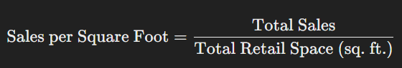
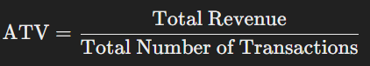
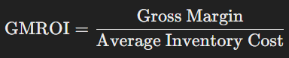
KPIs (Key Performance Indicators) Used in Retail:
2025
Sales per Square Foot
Average Transaction Value (ATV)
Measures how efficiently store space generates revenue. (Higher values indicate better space utilization.)
Measures the average amount spent per customer per visit. (Higher ATV suggests successful upselling or bundling.)
Gross Margin Return on Investment
Calculates profit earned per dollar spent on inventory. (Higher GMROI means better inventory profitability.)

Slide 8
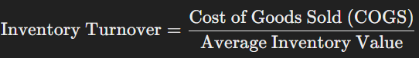
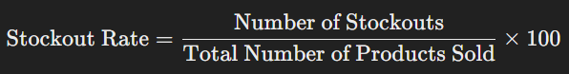
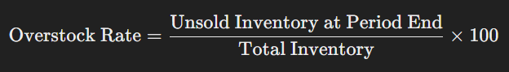
Inventory & Supply Chain Metrics
2025
Inventory Turnover
Stockouts & Overstock Rates
Tracks how often inventory is sold and replaced over time. (High turnover means efficient inventory management.)
Measures how often products are unavailable or overstocked, impacting sales and storage costs. (Lower stockout rates improve customer satisfaction.)

Slide 9

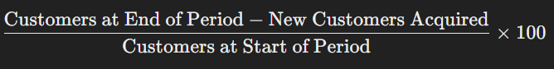

Customer Experience & Engagement Metrics
2025
Foot Traffic
Tracks the number of customers visiting a store, helping retailers optimize staffing and layout. (Higher foot traffic can indicate better marketing or location strategy.)
Customer Retention Rate
Percentage of repeat customers, indicating loyalty and long-term value. (Higher retention means strong customer relationships.)
Net Promoter Score (NPS)
Gauges customer loyalty and likelihood of recommending the store. (A high NPS indicates strong brand advocacy.)
Customer Satisfaction Score (CSAT)
Measures customer experience based on feedback surveys. (Higher CSAT reflects better service and product quality.)

Slide 10
Example
Scenario: Using GMROI to Improve Inventory Decisions
2025
A retail data analyst at a fashion store reviews GMROI data and notices that designer handbags have a low GMROI compared to casual footwear. This indicates that handbags are tying up inventory costs without generating sufficient profit, while footwear is performing well.
Steps Taken:
Identify Underperforming Inventory
The analyst finds that handbags take longer to sell and require heavy discounts to move, reducing overall profitability.
Reallocate Inventory Investment
Reduce future orders for handbags and shift investment toward fast-selling, high-GMROI products like casual footwear.
Adjust Pricing & Promotions
Introduce limited-time discounts or bundle handbags with popular items to improve sell-through rates without excessive markdowns.
Supplier Negotiation
Work with handbag suppliers to negotiate better wholesale prices or flexible order quantities to improve margins.
Optimize Stock Placement
Use sales and heatmap data to reposition handbags to higher-traffic store areas for better visibility.

Slide 11
Case Study: How Walmart Leverages Data Analytics for Competitive Advantage
2025
Inventory Management: Real-Time Tracking & Demand Forecasting
Walmart uses advanced predictive analytics and IoT to manage inventory across its global supply chain.
Implementation:
Real-time data from RFID tags and IoT sensors track product movement.
AI-driven demand forecasting predicts stock requirements based on sales trends, weather conditions, and local events.
Automated restocking ensures shelves are replenished before products run out.
Customer Loyalty: Personalized Marketing & AI-Driven Recommendations
Walmart leverages customer data analytics to create targeted marketing campaigns and personalized shopping experiences.
Implementation:
AI-driven recommendation engines suggest products based on purchase history and browsing behavior.
The Walmart+ membership program provides tailored discounts, free shipping, and AI-optimized promotions.
Machine learning identifies customer segments to create hyper-personalized deals and promotions.

Slide 12
Continue…
2025
Sales Growth: Dynamic Pricing & AI-Powered Promotions
Walmart uses real-time pricing algorithms to remain competitive and maximize revenue.
Implementation:
AI continuously monitors competitor pricing, demand fluctuations, and customer behavior to adjust prices dynamically.
A/B testing helps determine the best promotional strategies for seasonal campaigns.
Geographical pricing allows Walmart to tailor prices based on location-specific demand.
Impact:
Reduced stockouts and overstock situations.
Improved supply chain efficiency, cutting logistics costs.
Faster product availability for customers.
Higher customer engagement and repeat purchases.
Increased customer satisfaction and retention.
Growth in eCommerce and omnichannel sales.
Competitive pricing ensures higher market share and profitability.
Increased conversion rates for both online and in-store shoppers.

Slide 13
THANK YOU!
2025

